Slide 1


Group Project
CRISPR Screening and Analysis
Online learning week
28 July - 1 August
Matt Coelho & Kalpana Surendranath 2025 WCS CRISPR

Slide 2
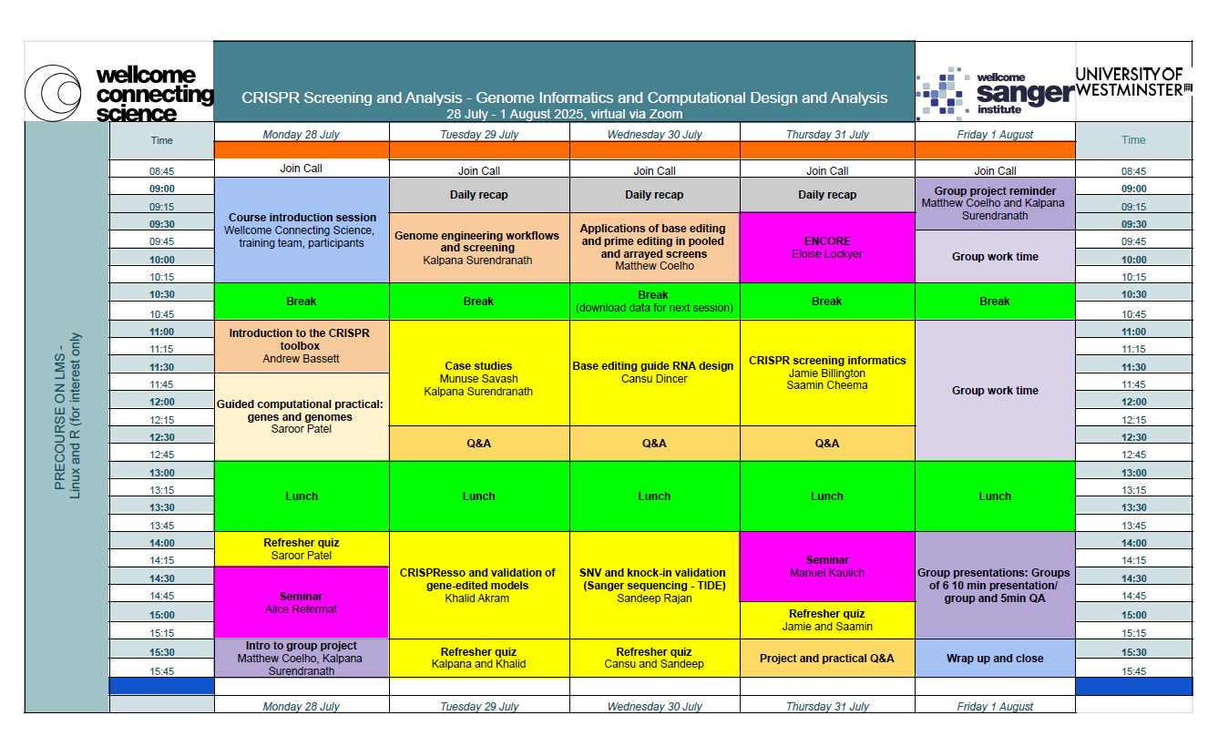

Slide 3
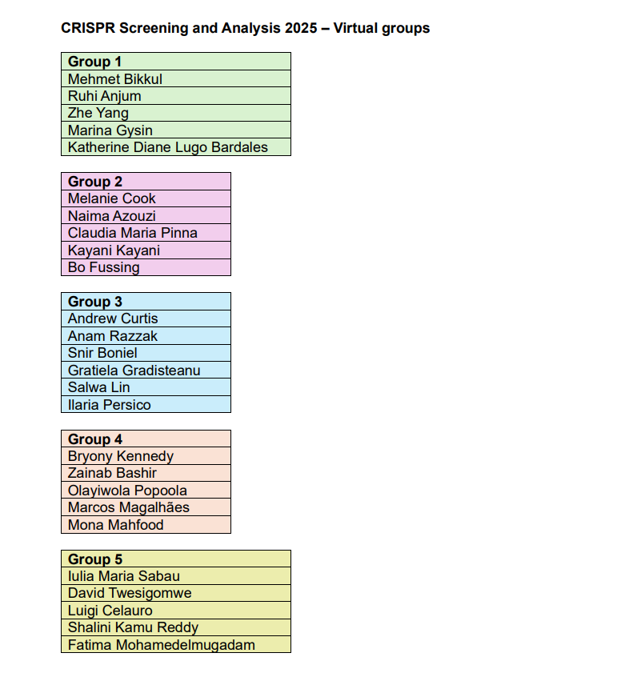
Virtual Groups

Slide 4
Group Project
A missense mutation in the coding region of the SRY gene (g.2787144A>G, p.C154R) has recently been found to alter the expression of the protein. This leads to an uncommon disorder in men.
The presence of the mutation does not always lead to disease, suggesting there are other factors at play. Your research team have been tasked with identifying genes involved in disease progression - particularly new drug targets to reverse the disorder.
Matt Coelho & Kalpana Surendranath 2025 WCS CRISPR

Slide 5

Groups’ tasks
Describe a CRISPR-based workflow to introduce the mutation in SRY in an appropriate cell model and verify the mutation.
Describe how you would design a CRISPR KO screen to identify modulators of SRY expression in this modified cell model.
Describe next steps after the screen, including a validation strategy.
For each step, give a rationale for your approach and describe the analysis in each case.
Matt Coelho & Kalpana Surendranath 2025 WCS CRISPR

Slide 6

Modelling the SRY Promoter Mutation - Pointers
What is your model system?
Should it naturally express SRY? How about the efficiency of genetic manipulation?
Your choice of CRISPR tools to introduce a precise genetic alteration
Optimal method to provide correct copies of the DNA? How would you deliver the tools into the cells?
What methods will allow you to screen for the correction?
What methods can be used to measure both RNA and protein levels?
Matt Coelho & Kalpana Surendranath 2025 WCS CRISPR

Slide 7
CRISPR Knockout Screen - Pointers
How will you ensure the mutation is present? What factors will limit your analysis of more genes?
What readout will allow you to separate cells with higher or lower expression?
How will you sort and collect the most interesting/informative population of cells?
What sequencing strategy will allow you to identify sgRNAs?
How will you leverage the sequencing data to find candidate genes worth investigating further?

Slide 8
Group presentation
15 min per group
10 min for presentation and 5 min for questions
All the best!

